Slide 1

Predicting Missed work Days
The Half Class Squad
Rick Clauss, Armi Cachilla, Alex Talento, Tyler Cobb, John Rafferty, Yazan Rizeq, Hadijat Makinde

Slide 2
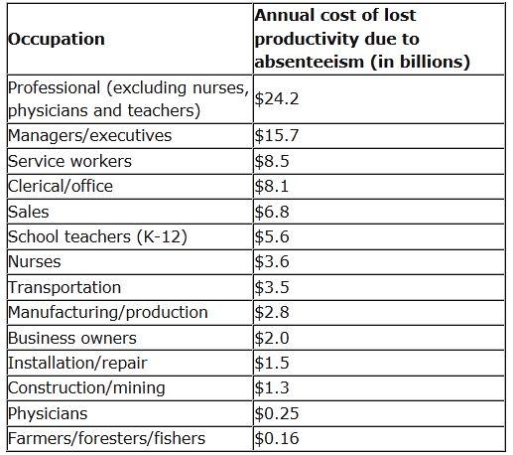
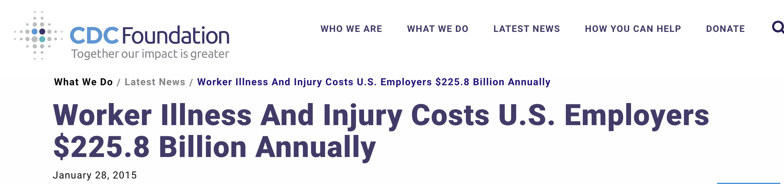
Missing work
The Centers for Disease Control and Prevention (CDC) reports that productivity losses linked to absenteeism cost employers $225.8 billion annually in the United States, or $1,685 per employee
Additionally, chronic diseases, a rapidly-aging workforce and factors like stress, fatigue and depression all affect employers’ revenue.
Forbes.com -July 2013
CDC foundation-Jan 2018
https://www.forbes.com/sites/investopedia/2013/07/10/the-causes-and-costs-of-absenteeism-in-the-workplace/#7a480bfe3eb6
https://www.cdcfoundation.org/pr/2015/worker-illness-and-injury-costs-us-employers-225-billion-annually

Slide 3
Calling in sick
While employers expect workers to miss a certain number of workdays each year, excessive absences can equate to decreased productivity and can have a major effect on company finances, morale and other factors.
Some reasons for Missing work include:
Bullying and harassment
Burnout, stress and low morale -
Childcare and eldercare - Depression
Disengagement -
Illness -
Injuries -
Job hunting -
Partial shifts

Slide 4
Aim of our project
To use machine learning to predict how often an employee will miss work.
The algorithm will be trained based on information gathered from the employee at the time of employment as well as other features.
information will include:
Reason for absence,
Social smoker/drinker,
Pet,
Distance from Residence to Work,
Age,
Education,
Children

Slide 5
How do we go about achieving this?
Obtained data from: University of California Irving https://archive.ics.uci.edu/ml/datasets/Absenteeism+at+work
The data set was originally used in academic research at the Universidade Nove de Julho - Postgraduate Program in Informatics and Knowledge Management.
Analysis:
We created a database using Postgres, queried the data using Tableau and created a visualization dashboard
We imported the data into jupyter notebook to apply our machine learning algorithms
Libraries include:
pandas, numpy, matplotlib, seaborn, sklearn, imblearn, and. we then use pandas read_csv() to read the data
Presentation.

Slide 6
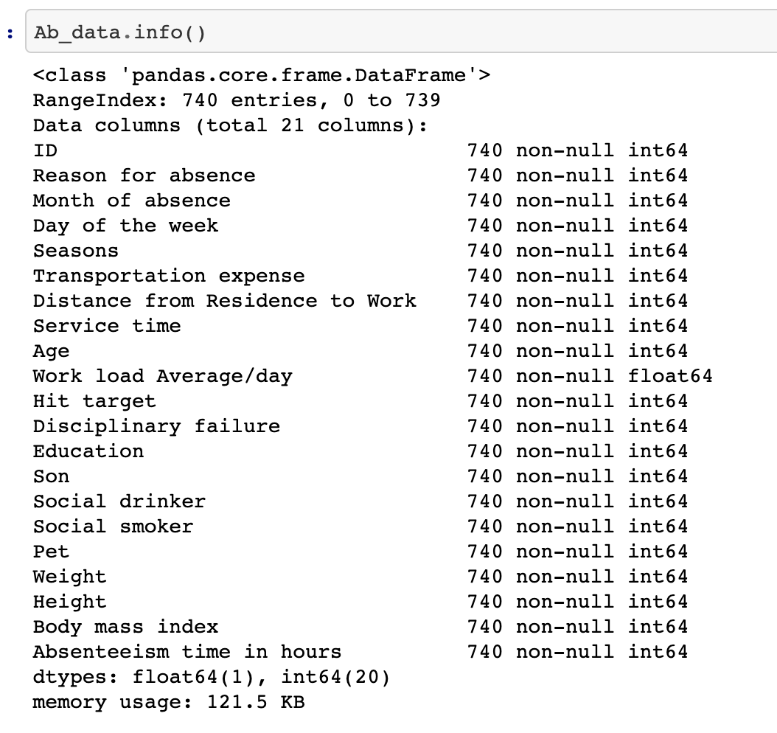
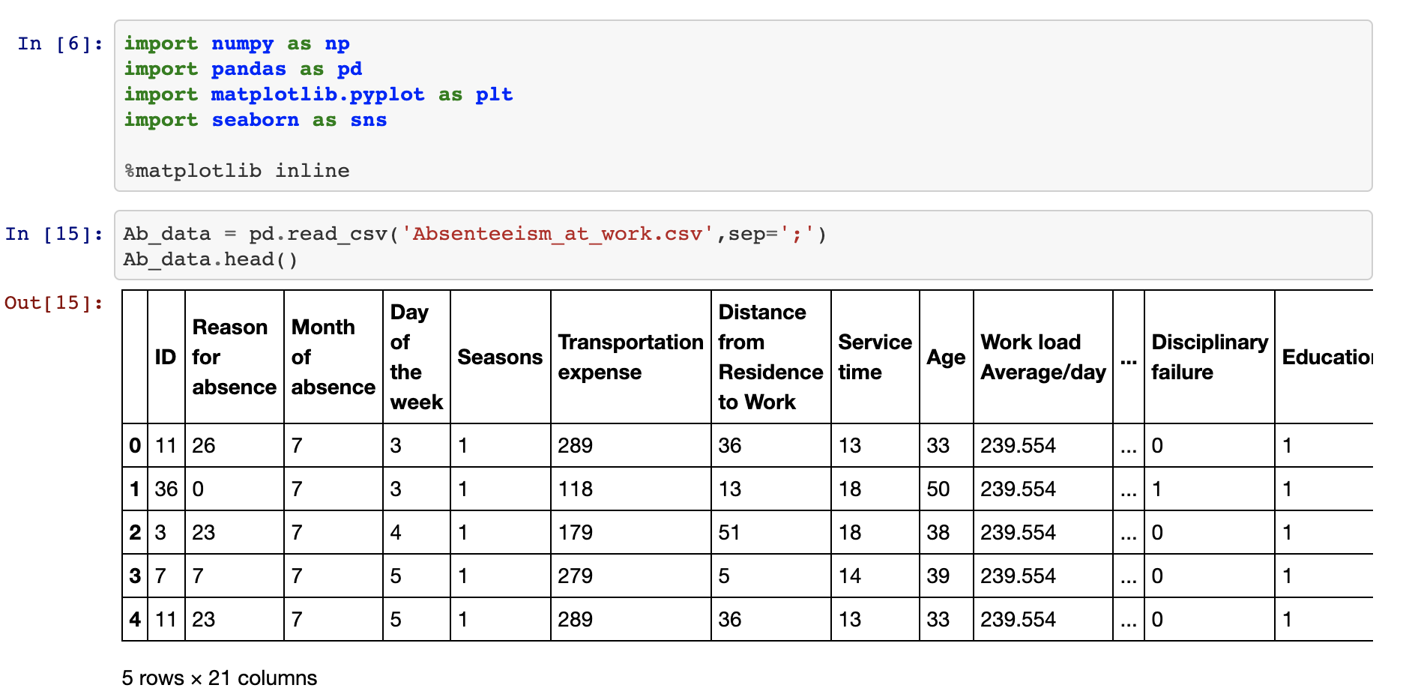
The dataset has 740 examples and 21 features

Slide 7
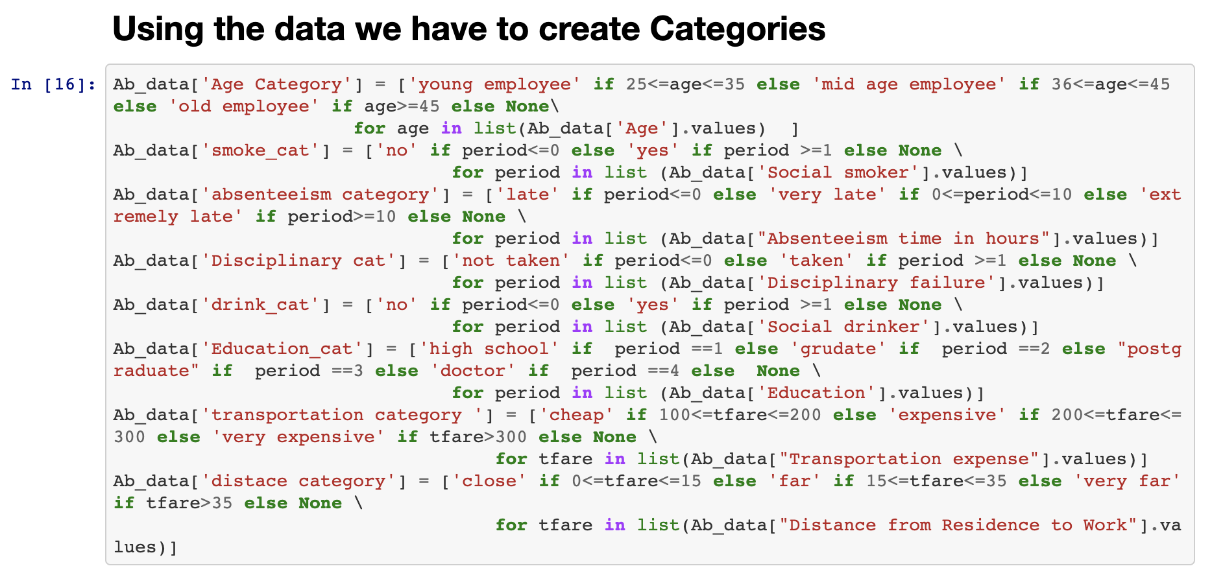
Creating categories so that we can train our dataset

Slide 8
Build our model
We split our data into train data and test data in the ratio 70:30 taking our target to be the absenteeism category and choosing features that could be gotten from an employee during recruitment.
We'll train our data with the following machine learning algorithm:
Naïve bayes
Random forest
Logistic regression
Support vector machine.

Slide 9
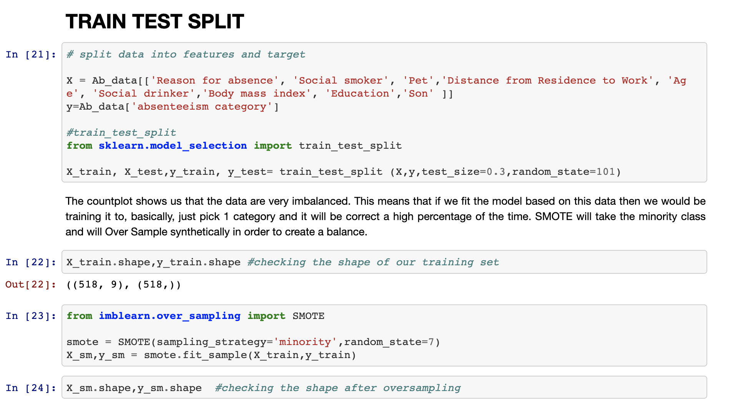
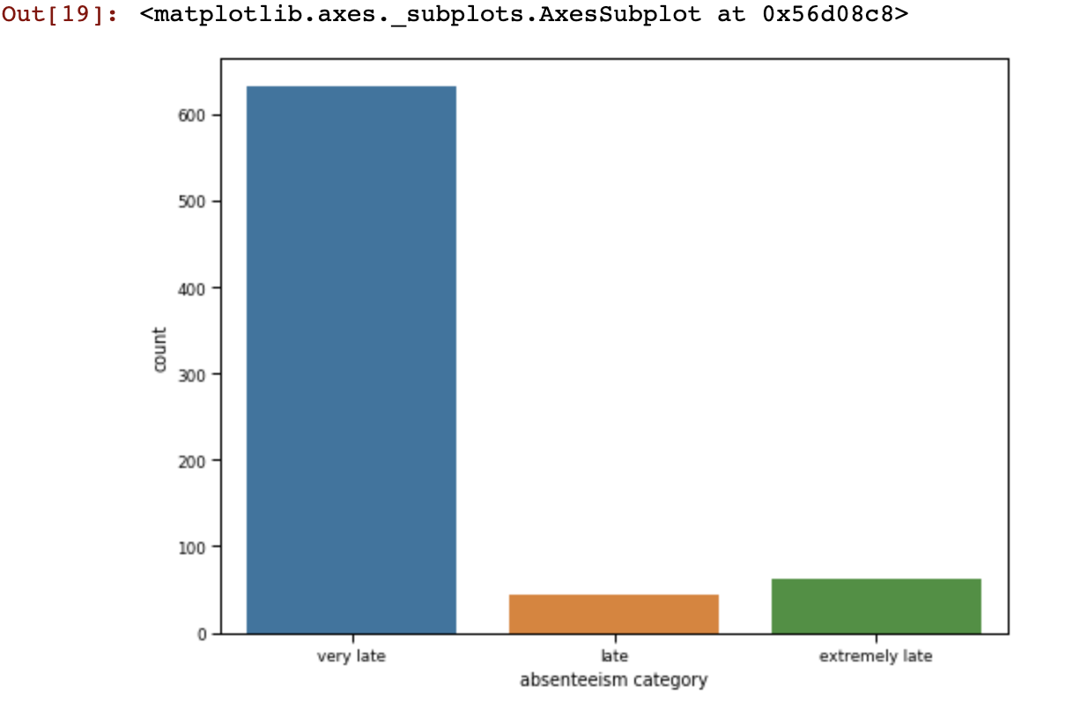
Check target column to see if it’s balanced before you continue to the next step
Apply a technique called oversampling. the most common oversampling technique is SMOTE (Synthetic Minority Over-sampling Technique).

Slide 10
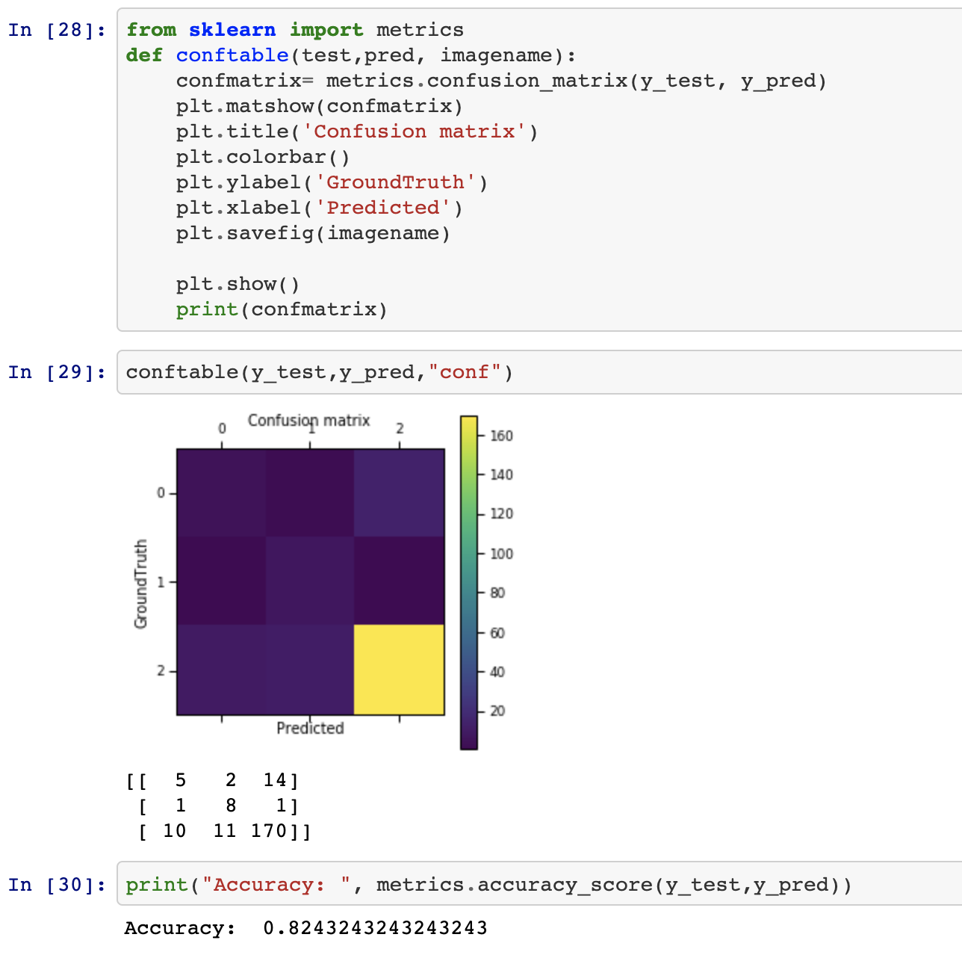
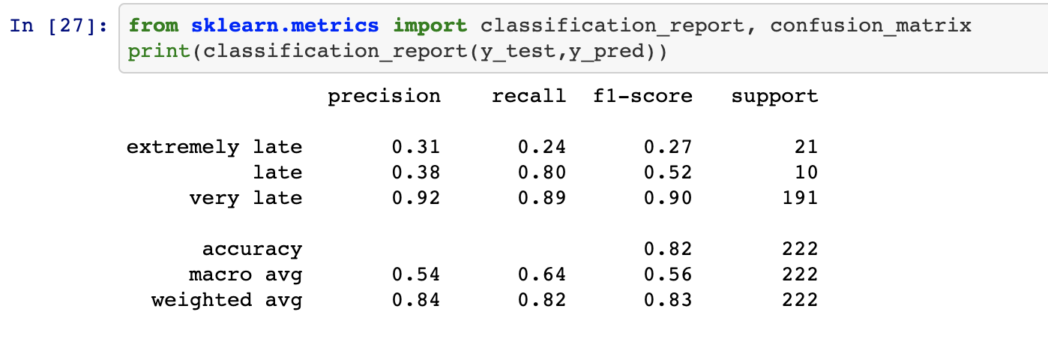
NAIVE BAYES

Slide 11
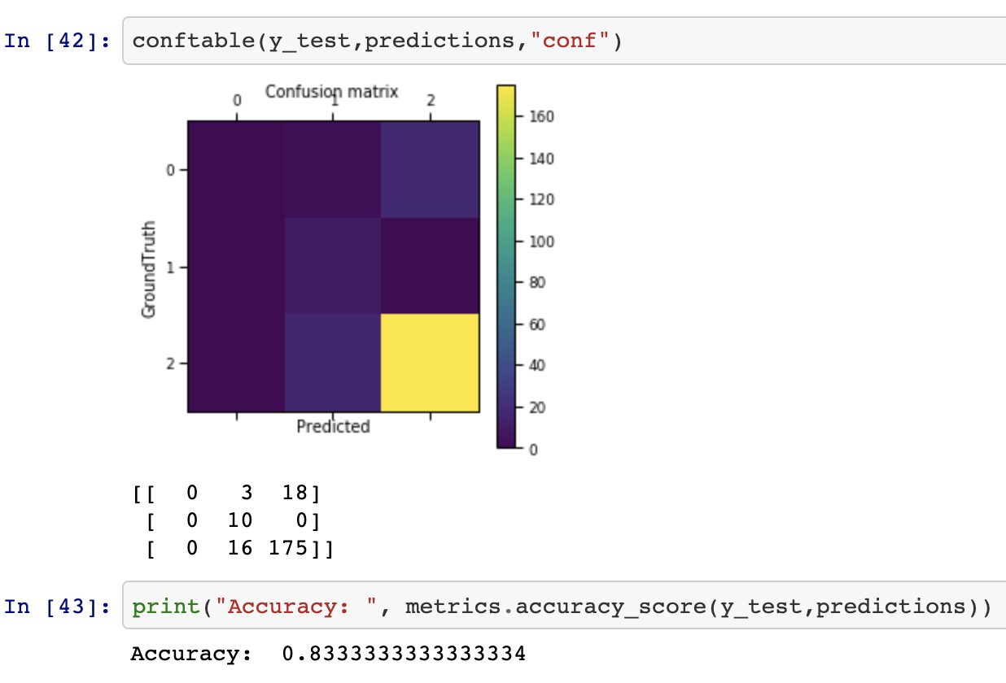
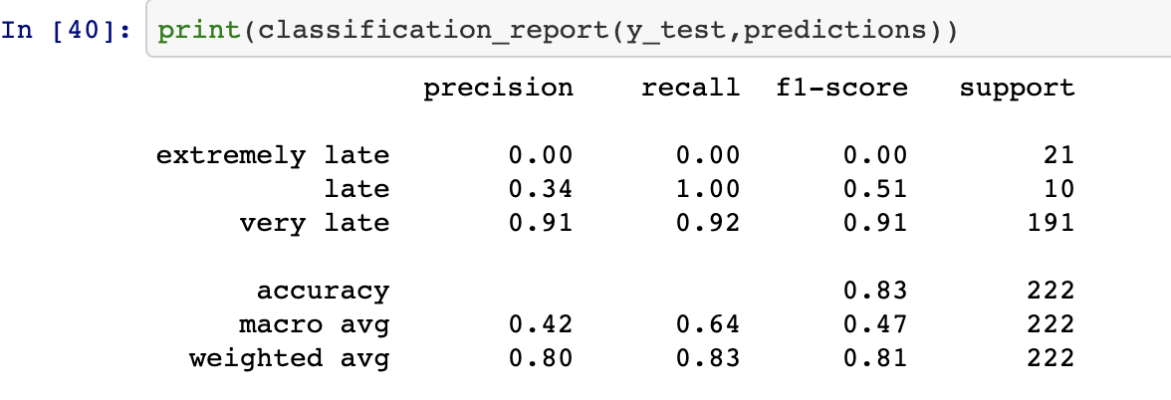
LOGISTIC REGRESSION

Slide 12
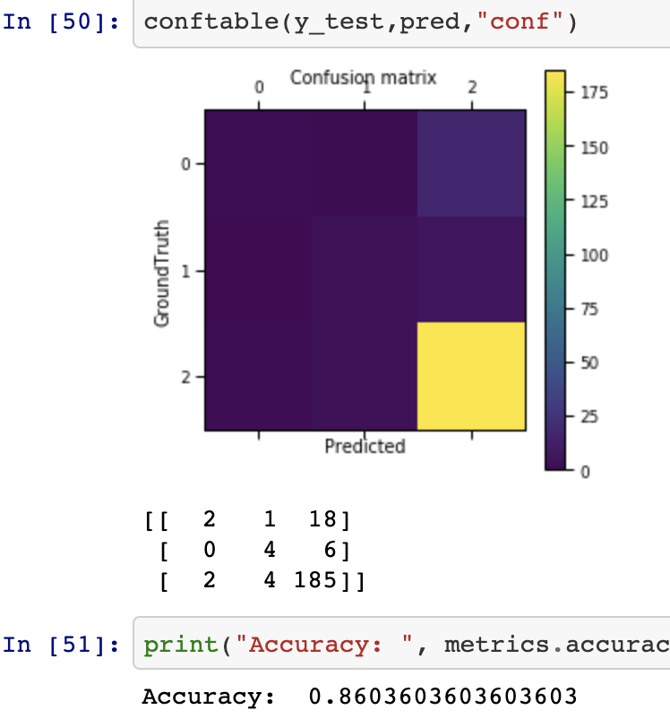
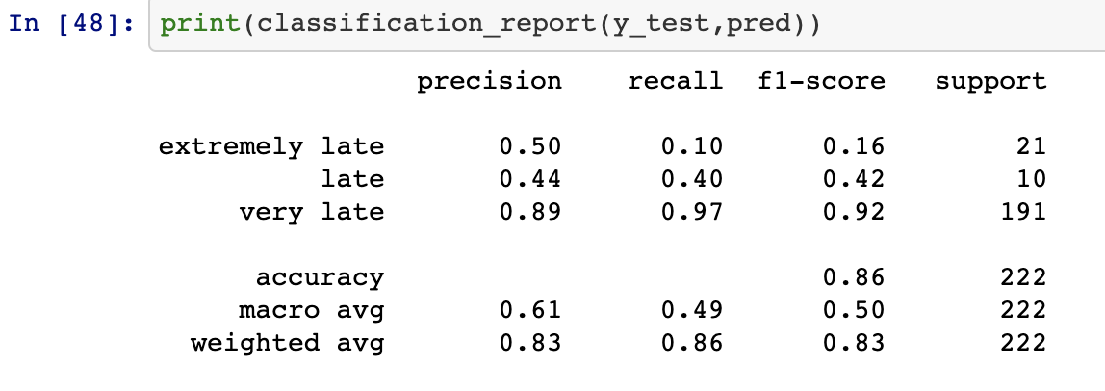
SUPPORT VECTOR MACHINE

Slide 13
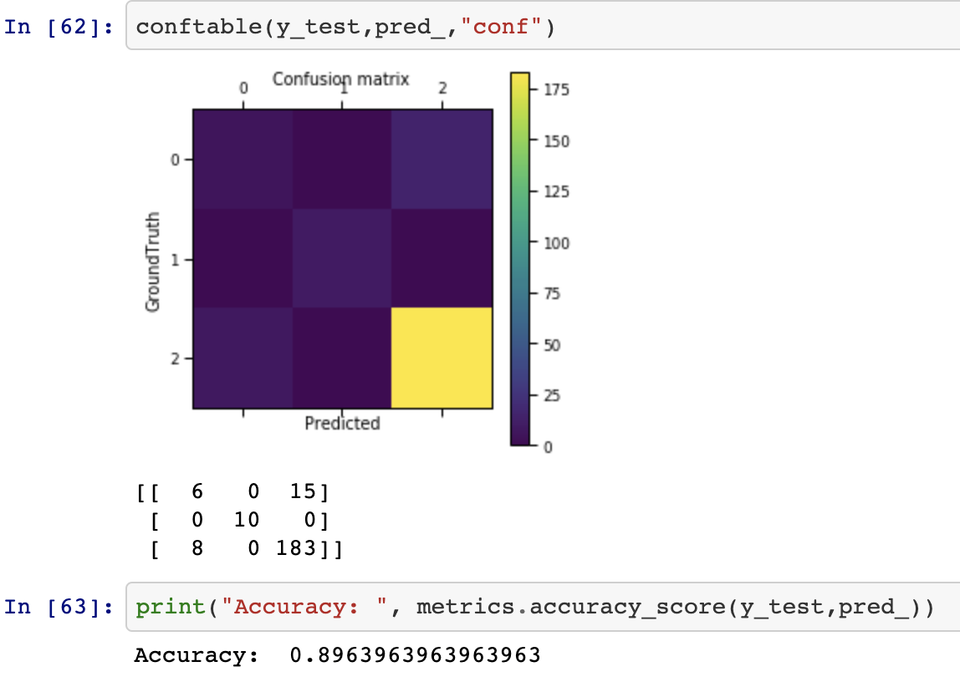
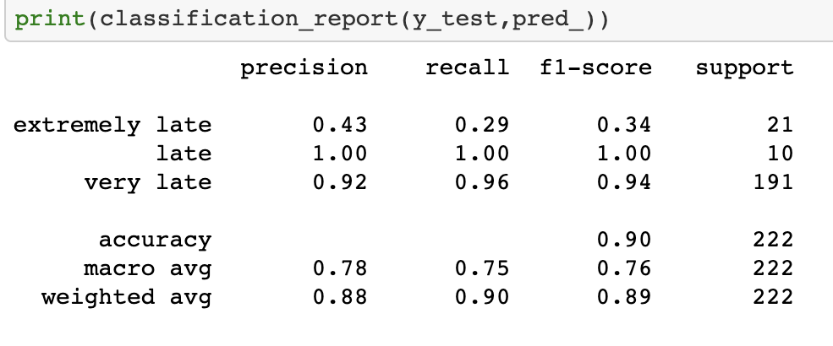
RANDOM FOREST CLASSIFIER

Slide 14
Observation
NB. 0.82
LR 0.83
SVM 0.86
RF 0.89
Random Forest classifier has the highest accuracy of the four algorithms that we tested , with an accuracy of 0.89
Random Forest is a supervised learning algorithm, it builds multiple decision trees and merges them together to get a more accurate and stable prediction

Slide 15
Conclusion
Machine learning can be used to predict the amount of times and employee will miss work
This can be used to manage revenue loss due to absenteeism

Slide 16


Acknowledgements
The Half-Class Squad
Yazan Rizeq
Armi Cachila
Alex Talento
Tyler Cobb
John Rafferty
Rick Clauss
Hadijat Makinde
QUESTIONS?

